Slide 1
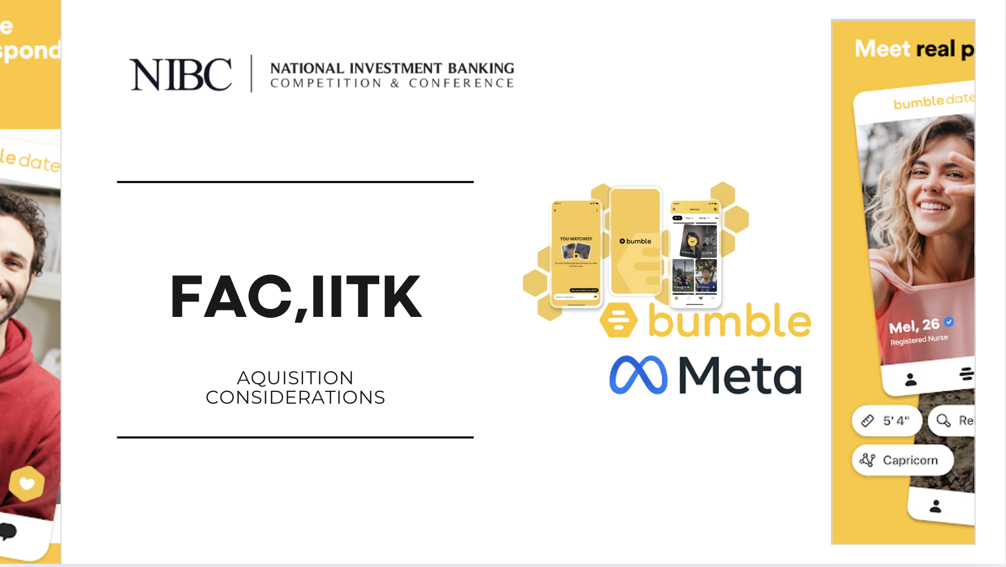
Acquisition Considerations

Slide 2


Executive Summary (Bumble)
Acquisition will establish Meta’s leading presence in the online dating industry, directly competing with Match Group
Rationale for acquisition of Bumble by Meta :
Significant Revenue and Cost Synergy Potential
Diversify Revenue streams and decrease Business Risk
Attractive Time to Acquire given Bumble's Market Performance
Enhanced Algorithm and Metaverse Experience
Strategic Summary
The acquisition strategically enhances Meta’s ecosystem and solidifies its leadership .
Premium : At $11 per share with a premium of 30%. Total acquisition cost: $1.73 billion (157 million shares outstanding).
Transaction Financing : 100% Cash Deal . Fully funded through Meta’s $44.40 billion cash reserves, utilizing 3.89% of available cash. No external debt or equity issuance, ensuring no dilution to Meta shareholders.
Financial Summary
Realistic and reasonable offer for Bumble
Risks
User Retention: Potential user backlash due to integration with Meta’s platforms.
Cultural Misalignment: Challenges in aligning Bumble’s brand identity with Meta’s ecosystem.
Regulatory Scrutiny: Increased oversight due to Meta’s dominant market position in social platforms.
Mitigants
Enhanced User Engagement: Meta’s platform scale can drive significant user growth and retention.
Brand Autonomy: Maintain Bumble as a standalone brand to preserve its culture and loyal user base.
Proven Integration Strategy: Meta’s successful acquisitions (e.g., Instagram, WhatsApp) demonstrate its ability to navigate regulatory scrutiny and extract value.
Considerations
Summary
Risks and mitigants and strategic alternatives
The Acquisition of Bumble by Meta Will Generate Significant Synergies, Positioning the Combined Entity to Solidify Its Leading Position the online dating and social media industry , and Drive Growth in Emerging Markets .

Slide 3




Competitive Landscape
Bumble Competes in the Online Dating Industry
 | Bumble Inc. | Match Group | Kakao | Hello Group
Main Areas | Women-focused networking | AI –based interactions | Messaging and Communication | Social Networking and Dating Services
Key Brands | Bumble Badoo Fruitz Official | Tinder Hinge OkCupid PlentyOfFish | Kakao Talk Kakao Entertainment Kakao Games | Momo Tantan SoulChill TieTie
Geography | North America (70%) International (30%) | North America (50%) International (50%) | South Korea (97%) International (3%) | Predominantly in China Has a presence in Hongkong, Singapore, and Japan
Headquarters | Austin, Texas, US | Dallas, Texas, US | Jeju, South Korea | Beijing, China
Recent Events | Acquired Geneva | Acquired HyperConnect | Acquired SM Entertainment | Acquired Tantan
ESG Score | 23.3 | 16.7 | 20.9 | 25.3
Bumble is currently relatively smaller in the global dating industry and therefore needs to take strategic actions to gain market share

Slide 4
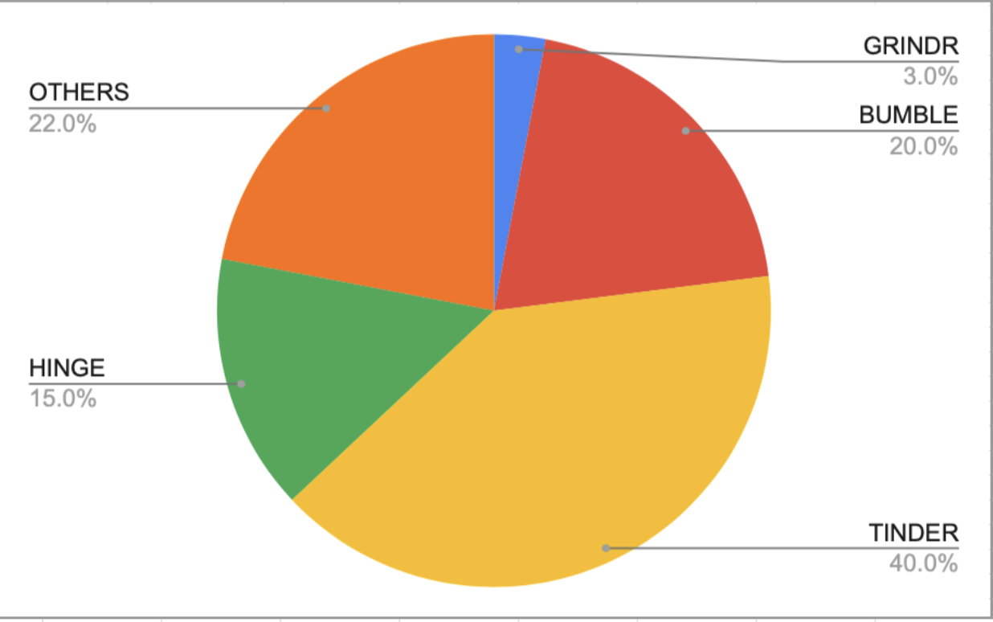
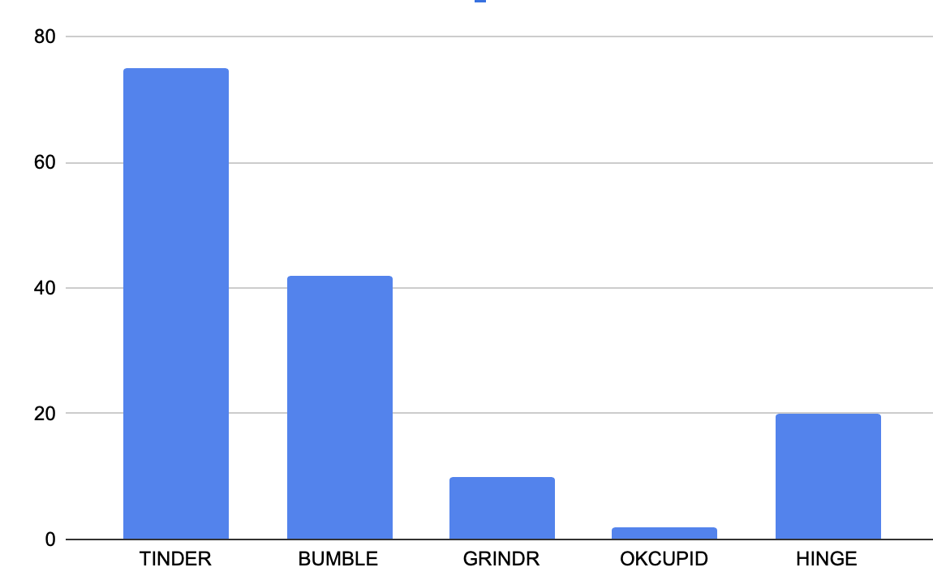
Industry – Statistics (Online dating space)
Industry Overview
Industry Characteristics:
Total Debt/EBITDA | 1-2
Total Debt/EV | <1
EBITDA margin | 28-30%
EV/EBITDA | 16-18x
Cash Ratio | 1-1.5
Market share held by 5 major companies(in North America) | 76.04%
Regional analysis by revenue share:
North America | 36%
Europe | 20.04%
Asia(data for China and India) | 20%
Latin America | 7-10%
Africa and Middle-east | 5-8%
Market share held by India,China,USA and Canada | 39-44%
Global Industry
Total revenues | $8.64bn
Forecasted 5-year revenue growth | 7.6%
Revenue Profile
Covid-19 increased user engagement across all platforms. The social acceptance of online dating ever since, has lead to a steady increase in users ever since.
Resilience in revenue streams despite economic fluctuations, due to the freemium model and growing adoption of subscription-based features.
Market share of the major companies by revenue:
Total Users (in million)
Source: Grand Research View
*source GrandViewResearch

Slide 5
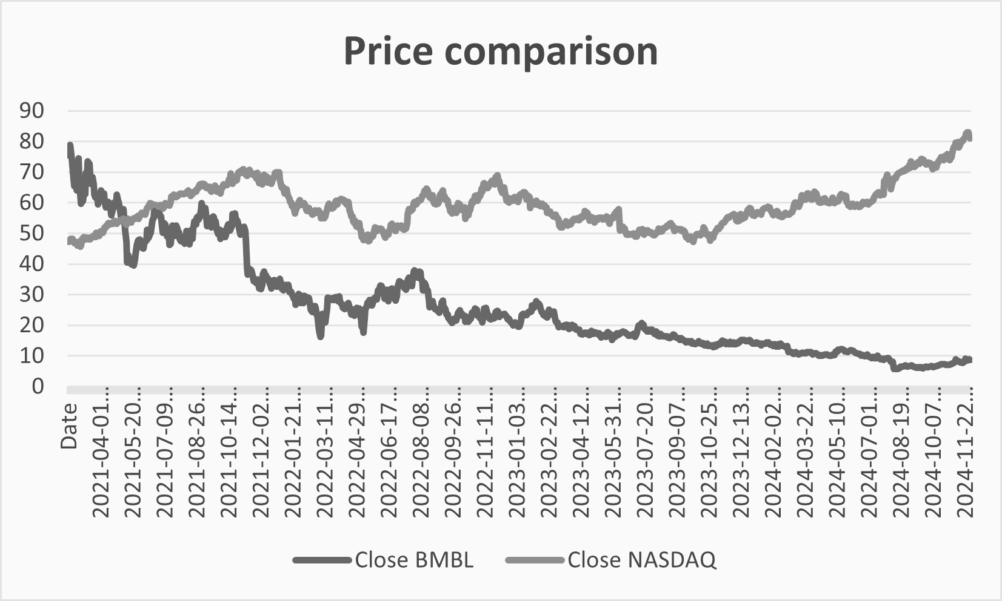
Company – Overview
Company Highlights
History: Founded in 2014 as Bumble by initial funding of $10mn by MagicLabs (est. 2006). Valuation: Bumble’s market capitalisation is decreasing constantly and now it is at $960.66 mm which is a decrement of nearly 52% from last year Strategy: Empowering women with its unique ‘women’s first approach’ by allowing women to message first in heterosexual matches. Corporate Finance Transactions: was previously owned by MagicLabs; the majority of the shares were held by Blackstone in 2019; it released its IPO in Feb 2021 and started to buy back its shares. Ownership: Blackstone (27.84%), Vanguard (9.84%), Blackrock (9.59%).
Valuation & Share Performance
Enterprise Value | $1.06B | Revenue (FY24Q3) | $273.6
Market Cap | $718.12 | EBITDA (FY24Q3) | $82.6
P/E | 18.76 | EBITDA Margin | 30.2%
EV/EBITDA | 5.27 | Debt / EV | 45.69%
Cash | $252.1 | Total Debt | $618
Source: 2024 Q3 report
Key Valuation Statistics ($mm)
Content | Bumble In-App Net Revenue (e)
US | $142.93 million
Germany | $13.17 million
United Kingdom | $11.77 million
Canada | $9.94 million
Australia | $7.95 million
France | $4.3 million
Mexico | $4 million
Switzerland | $3.68 million
Netherlands | $2.39 million
Revenue Mix | % | Gross FY24Q3(mm)
Badoo & others | 19.5 | $53.4
Bumble | 80.5 | $220.2
Share Price | Current: $8.88 | High/Low: $75.4 / $6.01
Age Group distribution of Share of US online dating users
Revenue and EBITDA Forecast(mmn) | 2023 | 2024E | 2025E | 2026E | 2027E | 2028E | 2029E
Revenues | 1052 | 1278 | 1562 | 1918 | 2384 | 2981 | 3751
Revenues Growth Rate | 16.4% | 21.5% | 22.2% | 22.8% | 24.3% | 25.0% | 25.8%
EBITDA | 228 | 104 | 62 | 97 | 164 | 245 | 256
EBITDA Margin | 21.7% | 8.2% | 4.0% | 5.1% | 6.9% | 8.2% | 6.8%

Slide 6
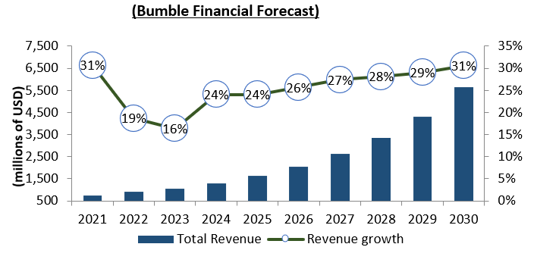
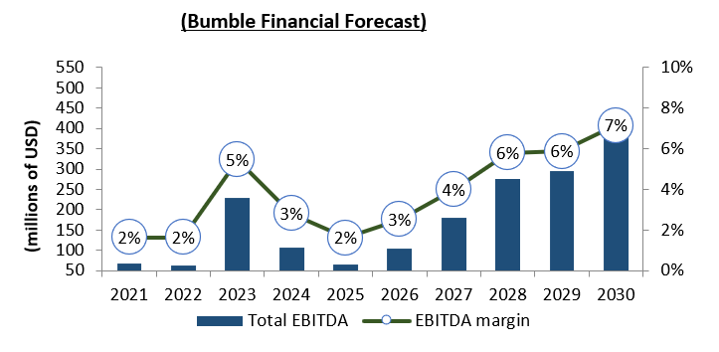
Company – Financial Forecast
Total Revenue and Growth
Trajectory
Significant growth in digital revenues: Bumble has experienced substantial growth driven by digital subscription revenues, particularly from its core platforms like Bumble Date, BFF, and Bizz. However, challenges remain as Bumble navigates slower adoption or declining performance in legacy features or geographies.
Positive Drivers
Cost Management: Bumble’s management has increasingly focused on cost-cutting measures, such as refining marketing expenditures through targeted campaigns and user acquisition strategies to improve margins. Prioritization of Core Offerings: Bumble focuses on optimizing its matchmaking platform and prioritizing resources for flagship features. Growth in Online and Mobile Dating: Bumble benefits from the continued rise in online and mobile dating adoption, particularly among younger demographics, where it holds a competitive advantage. Integration of New Technologies: Bumble leverages AI-based matching algorithms and deeper integrations with Apple and Google ecosystems to boost user growth and engagement. Woman-Driven: Bumble holds a strong position in the online dating market, especially appealing to women due to its unique "women-first" approach.
Total EBITDA and Margin
Negative Drivers
Industry Competition: Increasing competition from Match Group (Tinder, Hinge), new entrants, and niche apps poses challenges for Bumble to differentiate itself, maintain market share, and sustain pricing power. Revenue Volatility: Bumble’s heavy reliance on premium subscriptions (Bumble Boost, Bumble Premium) creates volatile revenue streams, making it challenging for management to predict growth and allocate resources effectively. Operational Expenses: Higher costs associated with partnerships, app store fees (e.g., Apple and Google), and increased competition in paid marketing may weigh on margins and overall revenue growth.

Slide 7
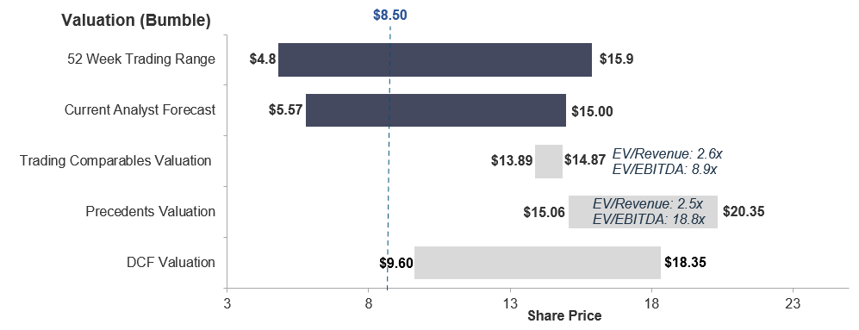
Valuation Football Field
Factors Affecting Bumble Stock Price
Peer Comparison: Bumble is fairly valued compared to its peers, though peer valuations have declined in line with broader market trends in media and technology.
Stock Performance: Bumble is trading near the lower end of its two-year range, driven by sector-wide weakness and declines in broader market performance.
Analyst Forecasts: One-year projections indicate a slightly bearish trend, with a forecasted price range of $5.75 to $10.00, signaling limited upside potential.
Current Valuation: Trading approximately 4.42% above its forecasted price, Bumble may be slightly overvalued, suggesting this is an opportune time to hold the stock.

Slide 8
Overview of Strategic Alternatives Available to Bumble
Meta acquires Bumble
 | Overview | Improved Growth Prospects | Increase Profitability | Likelihood of Approvals
Possible Initiatives
Riskiness of Implementation
Status Quo-Make no Acquisitions
No Acquisition: Bumble continues price competition with Match Group.
Impact: Revenue stays below potential, and debt levels rise.
Cost Optimization: Restructuring reduces expenses to boost profitability.
Operational Efficiency: Enhances margins while maintaining core operations.
Restructuring
New Features: Enhance customer retention through feature innovation.
Management Restructuring: Align employee feedback with organizational goals.
Strategic Initiatives
Significant cost and revenue synergies through reduced marketing expenses(marketing through Facebook ads) and sharing of data centers.
Expanding of user base and integrating with Instagram.
Sell to Meta
Bumble
Meta
Focus on authentic relationships and safe dating
Strength in women first platform dynamics
Global leader in social networking and technology
Advanced capabilities in AI, advertising and monetization
Bumble's Sale to Meta Will Create a Global Social Networking Powerhouse, Enabling Unprecedented Synergies Between Dating, Community Building, and Social Connectivity.

Slide 9
Summary of Rationale for Sale to Meta
Meta’s acquisition of Bumble aims to establish a leading presence in the online dating industry, directly competing with Match Group
Significant Revenue and Cost Synergy Potential
Revenue: Geographic expansion, leverage Meta’s humongous user base, build inter app connectivity with Instagram
Cost: Decrease in marketing, tech infrastructure cost through using Meta's plentiful resources
1
Diversify Revenue streams and decrease Business Risk
By acquiring Bumble, Meta can add another revenue stream as well test out Bumble’s freemium model for its other offerings.
This strategic expansion aligns with Meta's broader mission of connecting people while capturing users across various stages of their social lives.
2
Attractive Time to Acquire given Bumble's Market Performance
Bumble stock prices are trading near its book value.
Meta with a Debt to equity ratio of 0.3x and 21.85 Billion Dollars in net cash is in a healthy condition to acquire Bumble.
3
Enhanced Algorithm and Metaverse Experience
AI Integration: Bumble's user data and behavior insights can help Meta further refine its AI algorithms and advertising targeting capabilities.
Improving personalization across Meta’s platforms while enhancing Bumble's matchmaking processes.
4
By joining Meta, Bumble can realize a valuation uplift driven by enhanced profitability, reduced marketing expenses, and advanced AI integration.

Slide 10
Acquisition Considerations and Mitigants
Relatively Limited Downside With Bumble Acquisition Given Strong Strategic Rationale
Acquisition Considerations
Mitigants
_{A} User backlash due to integration with Meta platforms.
A
Bumble will retain brand autonomy as a standalone entity to preserve user trust and brand loyalty.
B Cultural misalignment risks between Bumble and Meta.
Meta’s proven track record of seamlessly integrating acquisitions (e.g., Instagram, WhatsApp) ensures smooth alignment.
B
C Valuation concerns amid Bumble’s recent performance.
C
The $11/share cash offer reflects a fair premium based on intrinsic DCF valuation and market comparables.
D
Risk of overlapping user base across Meta’s platforms.
D
Synergies will enhance platform differentiation and create new monetization opportunities without canibalization.
E
Regulatory scrutiny due to Meta’s market dominance.
E
Meta’s success with prior acquisitions and favorable antitrust precedents reduce regulatory challenges.
Key Insight: The acquisition strengthens Meta’s revenue diversification, preserves Bumble’s value proposition, and unlocks meaningful synergies while mitigating associated risks.

Slide 11
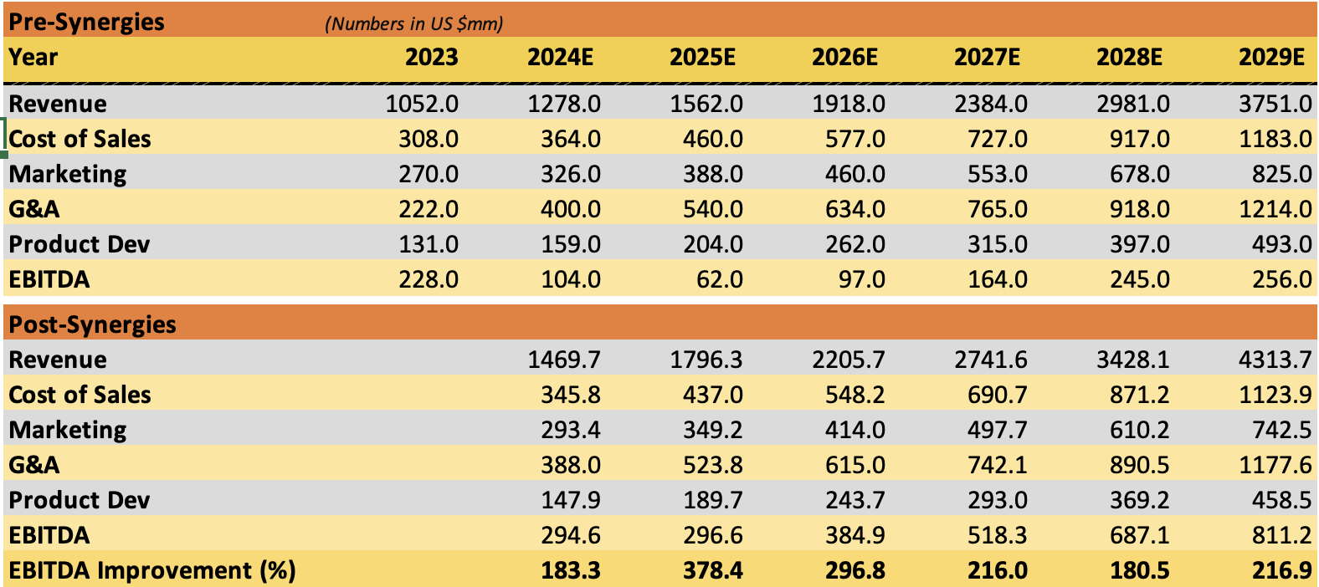
Transaction Overview
Transaction Overview
Meta acquires Bumble Inc at a premium of 30%
Meta acquires Bumble Inc at a premium of 30%
Acquisition Financing Overview
1.Transaction Structure:
100% Cash Deal at $11 per share with a premium of 30%. (Share price as of 15 November 2024)
Total acquisition cost: $1.73 billion (157 million shares outstanding).
2. Financing Source:
Fully funded through Meta’s $44.4 billion cash reserves, utilizing 3.89% of available cash.
No external debt or equity issuance, ensuring no dilution to Meta shareholders.
3. Post-Acquisition Impact:
Bumble will become a wholly-owned subsidiary of Meta.
Bumble shares will be delisted from public markets.
Bumble shareholders will receive $11 per share in cash upon transaction close.
Key Improvements
• EBITDA Margins: Projected to increase by 2.86x.
• EBITDA Growth: Average improvement of 2.45x over 5 years.
Synergy Assumptions
Revenue Synergies: 15% growth from integrating Bumble’s monetization model across Meta’s platforms.
COGS: 5% reduction via Meta’s infrastructure optimization.
Marketing: 10% savings through shared channels and lower acquisition costs.
G&A: 3% savings from streamlined operations.
Product Development: 7% improvement through shared R&D efficiencies.

Slide 12
Strategic Revenue Diversification: Reducing Ad Dependence Through Bumble’s Subscription Model
Revenue Diversification of Meta
Rationale #2 : Revenue Diversification of Meta:
Meta’s Revenue
Family of Apps
Ad-Revenue
Other revenues
Reality Lab
AR/VR related Hardwares/softwares
KEY INSIGHTS:
Strategic Impact: Bumble’s subscription revenue will contribute ~$200M annually, driving revenue growth and reducing Meta’s advertising reliance by 10% over 5 years.
Post-acquisition, Bumble’s subscription model will diversify Meta’s revenue streams, reducing reliance on advertising revenue (currently 97.8%)
Post Acquisition
Notes:
Currently, 96% of Meta’s revenue comes from advertising. The integration of Bumble introduces a subscription-based model, contributing $200 million annually and reducing Meta’s reliance on ad revenues by 10% over 5 years

Slide 13
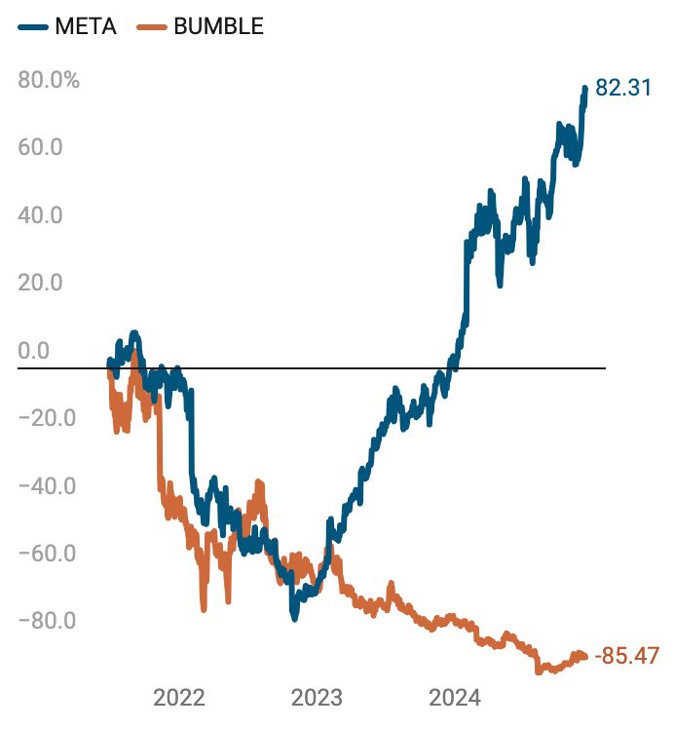
Attractive Time To Acquire
Bumble Is Trading Near its Book Value Creating A Unique Opportunity for Meta to Expand its Presence in the Dating Industry.
Financial Stability and Ample Cash Give Meta Capacity to Acquire
1
Bumble is trading close to its book value
Bumble is Trading at a premium of only 9% to its Book Value .
$8.27
Share Price
$7.57
Book Value per Share
2
Ample Cash Balance and Low Debt Levels
Meta would be able to acquire Bumble easily given their healthy financials.
$21.85B
Net Cash Balance
0.3x
Debt/Equity Ratio
3
Meta is Financially Healthy
Meta is no Financial Distress given its high Altman Z-Score
9.55
Altman Z-score
Bumble can benefit from integrating itself into Meta’s Family of Apps
Notes:
“This acquisition positions Meta to compete directly with Match Group, the current market leader in online dating. Bumble’s ‘women-first’ approach and differentiated features provide a strong competitive edge.”
“Bumble’s presence in emerging markets aligns with Meta’s global growth strategy, particularly in regions like India, China, and Latin America, where online dating adoption is accelerating.”

Slide 14
Rationale #4 :Technological Improvements, Algorithm Enhancements, and Metaverse Synergies
Technological Improvements, Algorithm Enhancements, and Metaverse Synergies
For Bumble
For Meta Platforms
AI Algorithm
Improvements
1
Personalized Matching: Meta’s advanced AI improves match accuracy using behavioral data, reducing churn rates.
Deception Detector: Introduced in February 2024, Bumble's machine learning model blocks up to 95% of fake profiles, boosting user trust and safety.
AI-Driven Advertising: Bumble’s user data enhances ad targeting for travel, events, and experiences.
Cross-Platform Personalization: Bumble insights optimize user recommendations across Instagram and Facebook.
AI Algorithm
2
Virtual Dating Spaces: Immersive 3D date experiences in Meta’s Metaverse .
Avatar-Based Interactions: Bumble users interact via avatars, reducing dating anxiety.
Scaling Virtual Connections: Expands Metaverse into social and dating spaces.
Quest 3s merges AI and Virtual Reality for Immersive User Experiences
Metaverse
Integration
Advanced Chat/Video: Meta’s real-time communication tools enable smoother video calls and chats.
AR Filters: Introduce AR-enhanced photos, filters, and profile personalization.
Data Synergy: Bumble’s user data improves Instagram and Facebook algorithms, driving better engagement.
Monetization Boost: Bumble’s freemium model enhances Meta’s monetization strategies and user retention via integrated dating features.
3
Feature Improvement
This acquisition enhances Bumble’s platform with Meta's cutting-edge technology, exponentially scales its user reach, and reduces costs—transforming it into a market-leading, tech-enabled dating platform.
Notes:
“Meta’s advanced AI and machine learning will enhance Bumble’s platform through:
• Improved matching algorithms for better accuracy.
• AI-based deception detection, blocking up to 95% of fake profiles.
• Integration with Meta’s Metaverse, enabling immersive dating experiences via avatars, AR filters, and virtual spaces.”

Slide 15

Conclusion
Recommendation to Sell Bumble to Meta and Engage Team FAC, IITK as Advisors
WHY HIRE FAC IITK
Proven expertise in synergy implementation, revenue diversification strategies, and post-acquisition integration.
Comprehensive expertise in Meta’s acquisition strategy, coupled with the capability to drive seamless negotiations while safeguarding Bumble’s autonomy as an independent brand.
Expertise in M&A
Strong domain knowledge in AI, social platforms, and subscription-based models.
Demonstrated expertise in applying advanced financial technologies and AI-driven analytics to enhance transaction efficiency and deliver strategic insights.
Technology Focused
Objective, conflict-free advisory to maximize shareholder value through a 100% cash deal at $11/share.
Robust valuation approach with a focus on DCF, market comparables, and precedent transactions.
Strategic Valuation
Team FAC, IITK brings unparalleled technical expertise, strategic acumen, and a professional advisory approach, positioning us as the ideal partner to steer this transaction and deliver exceptional value to Bumble's stakeholders.

Slide 16
APPENDIX

Slide 17
Industry – Timeline
(Online Dating and Social Media Industry)
Meta Platforms launches Facebook
Reddit is founded and Yelp Inc. is launched
Tencent Holdings Ltd. Acquires majority stake in Riot Games
Pinterest is founded
Weibo Corp. is launched by Sina Corp.
Meta Platforms acquires Instagram ($1bn)
Match Group acquires OkCupid
Hello Group launches Momo
Bumble is founded
2004 | 2005 | 2008 | 2010 | 2011 | 2012 | 2013
2014
2015 | 2016 | 2017 | 2018 | 2019 | 2021 | 2022
2024
Reddit launches IPO
Bumble expands into new markets in Asia,Europe
Bumble launches IPO
Pinterest launches IPO
Match Group acquires Hinge
Bumble Bizz is launched
Snap Inc. launches IPO
Bumble BFF is launched
Meta Platforms acquires WhatsApp ($19bn)
Match Group launches IPO

Slide 18





Business Models
Business Models
Each major player has focus on particular areas and channels with fairly significant variation in EBITDA margin; Bumble’s cost structure has become more efficient with improvements in operational expenses, but its international revenue growth is challenged by lower monetization rates .
Business Model
Company | LTM Revenues / EBITDA | Strategy | Main Areas | Geography (Revenue)
 | $156.5bn / $79.1bn (61%) | Strategy: Meta is diversifying from social media dominance into emerging technologies like the metaverse, AI-driven advertising, and VR/AR devices . Strength: Global scale with a massive daily active user base (over 3 billion).Advanced advertising tools and AI personalization drive high ROI for advertisers. Weakness: Heavy dependence on ad revenue (97% of total).Rising costs in developing the metaverse and regulatory pressures related to data privacy and monopolistic behavior . | Social networking, virtual reality . Instagram , WhatsApp , Oculus VR . | North America (43%) Europe (23%) Asia Pacific (21%) Other (13%)
 | $3.5bn / $990m (37%) | Strategy: Operates a portfolio of dating apps (Tinder, Hinge, Ok Cupid) to target diverse demographics globally, leveraging subscription models and premium features for monetization. Strength: Leadership in online dating, with Tinder being the most downloaded dating app globally . High user engagement and willingness to pay for premium features. Weakness: Dependence on North American markets and challenges in entering highly regulated or culturally resistant markets like China​ . | Online dating and AI-based interactions . Tinder , Hinge , Plenty of Fish , Hyper connect | North America (50%) International (50%)
 | $5.23bn / $-768m (11%) | Strategy: Aims to enhance user engagement through AR/VR innovation, Snap Map, and ephemeral content while monetizing via ads and partnerships. Strength: Pioneering AR capabilities and a loyal Gen Z user base. Weakness: Struggles to achieve profitability due to intense competition from larger platforms . | Social media, and content creation. Bitmoji , Wave Optics | North America (69%) Europe (19%) Other (12%)
 | $3.5bn / $177m (28%) | Strategy: A visual discovery engine for inspiration, Pinterest monetizes through e-commerce partnerships, shoppable pins, and targeted ads. Strength: Highly engaged female user base and strong alignment with e-commerce trends. Weakness: User growth slowing and struggles to compete against platforms with more robust video and social features like TikTok . | Visual content curation, e-commerce . Instapaper , VSCO’s Team , The Yes | North America (82%) Europe (10%) Other (8%)
 | $1.12bn / -$596m (26%) | Strategy: Focuses on niche, highly engaged communities (“subreddits”) . Strength: Deeply engaged user base driven by user-generated content. Weakness: Content moderation remains a significant challenge, impacting brand safety. | Social news aggregation, community forums Dubsmash , Alien Blue , Spell | North America (83%) International (17%)
 | $1.1bn / $190m (0.3%) | Strategy: Differentiates by positioning itself as a women-first platform in online dating, while expanding into adjacent areas like friendship (Bumble BFF) and professional networking (Bumble Bizz). Strength: Unique approach empowers women, creating brand loyalty. Weakness: Faces competition from established players like Tinder and new entrants globally . | Online dating, women-focused networking Badoo , Chappy , Fruitz | North America (70%) International (30%)

Slide 19
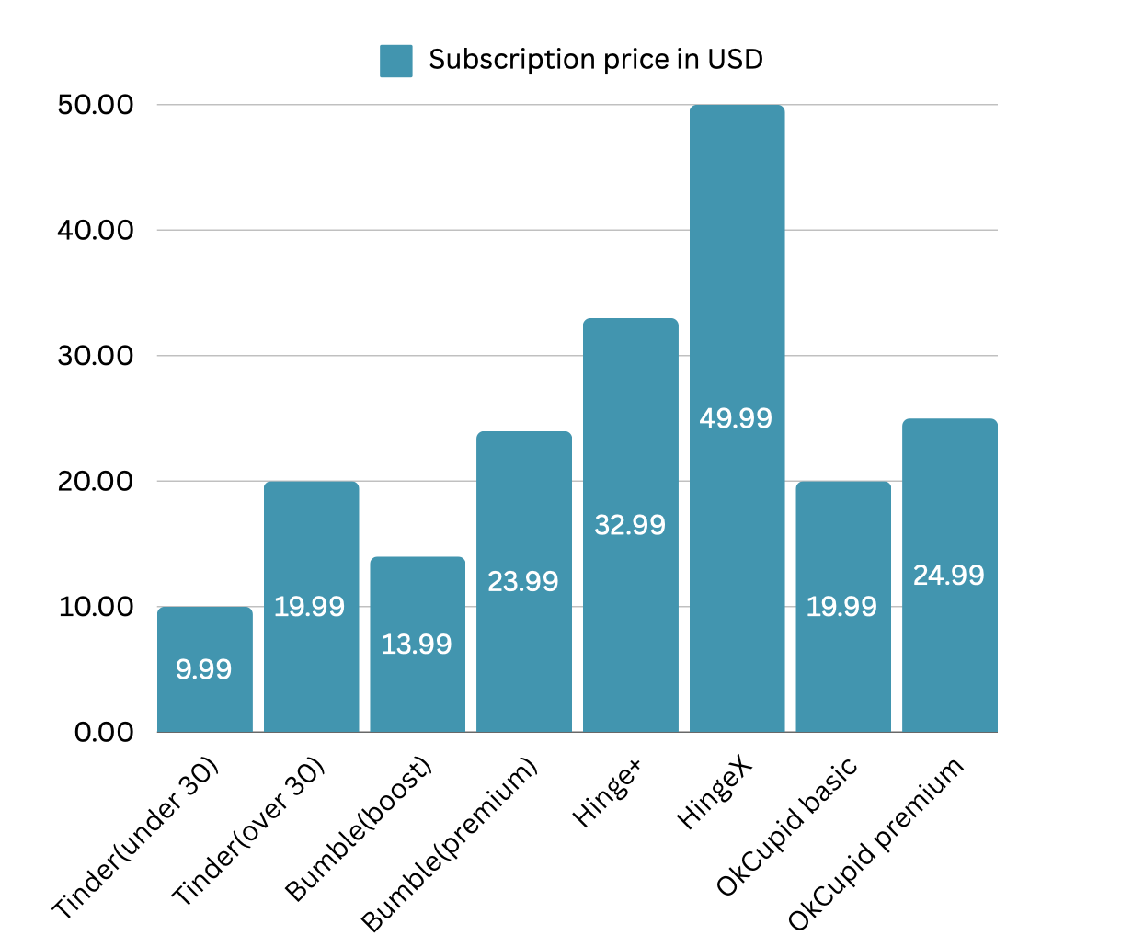
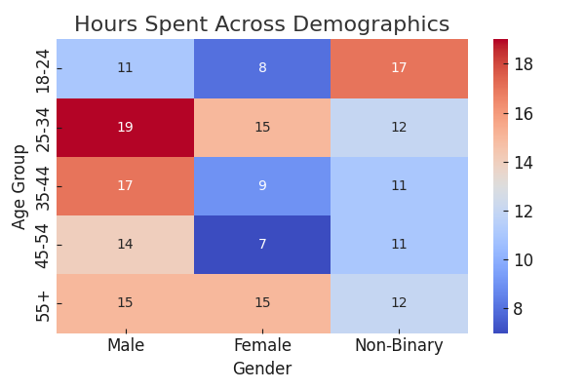
Industry-Statistics(Online Dating space)
Subscription price comparison
Demographic heat-map on dating sites

Slide 20
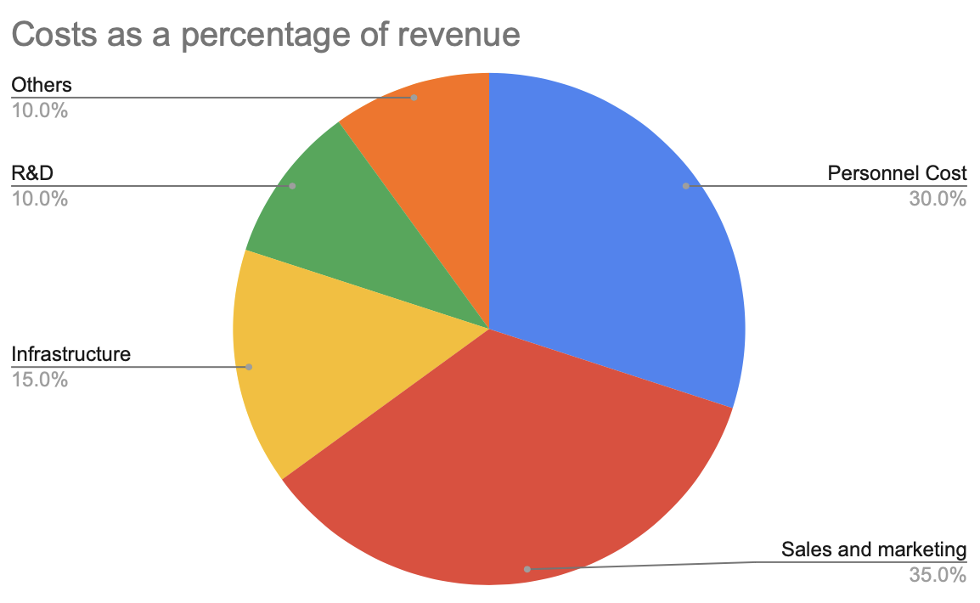
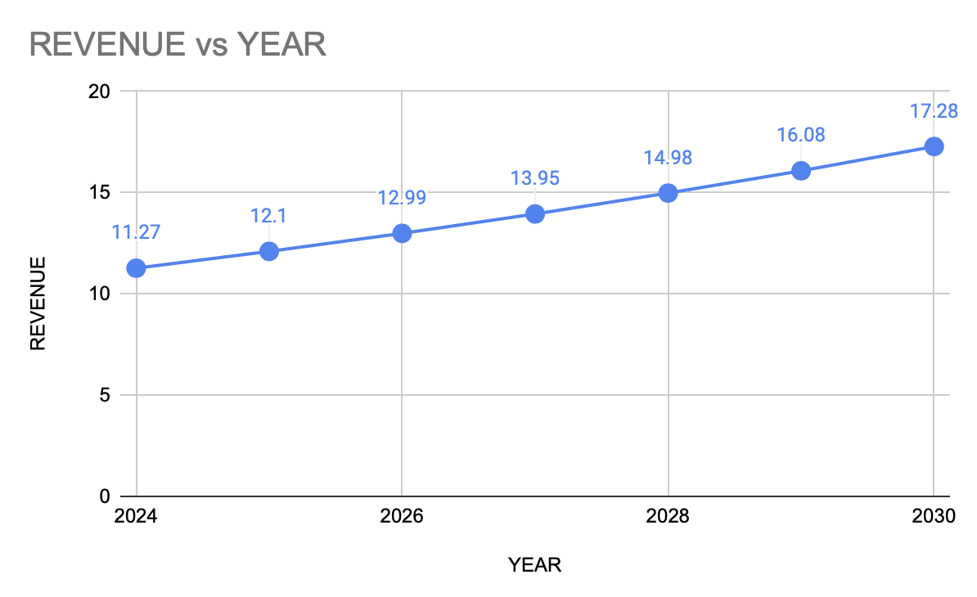
Industry – Overview(Online Dating space)
Financial Aspects:
Revenue : As much as 62% of the total revenue in this industry comes from premium subscriptions. The remaining 38% is from other segments like advertisements. The average revenue per user (ARPU)varies geographically from between $2 to $10.
Expenditure:
Personnel cost (Salary paid to staff) is almost 30% of the total revenue.
Total Sales and marketing cost is as high as 35%.
Services and infrastructure cost i.e the cost for database management, using cloud hosting services etc accounts for roughly 10-15% of the total revenue cost on average.
Cost of Research and Development is around 10%
Other expenses like General administration and Legal and compliance account for the remaining 5-10%.
Projected growth
The industry has grown consistently at about 8-9% on an average in the past.
It is expected to grow at 7.34% CAGR till 2030 reaching $17.28 billion.

Slide 21
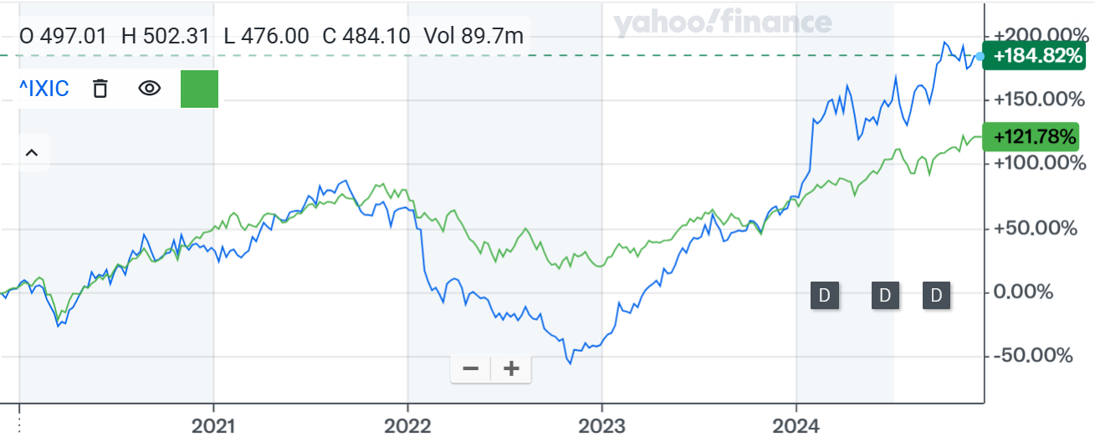
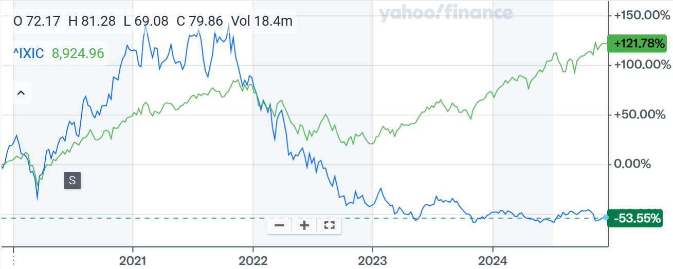
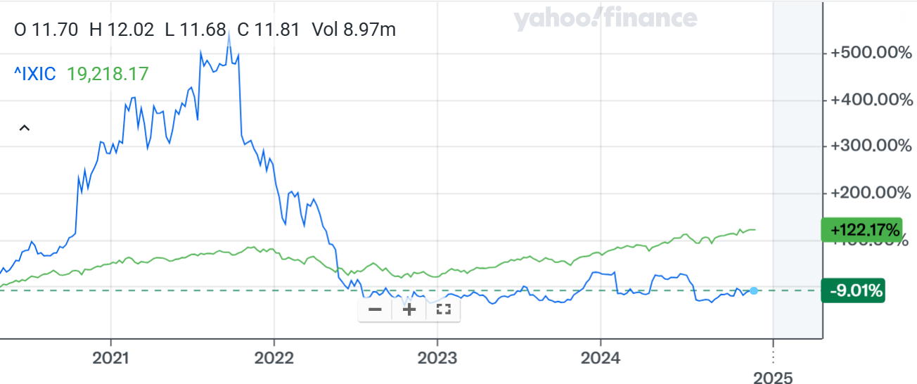
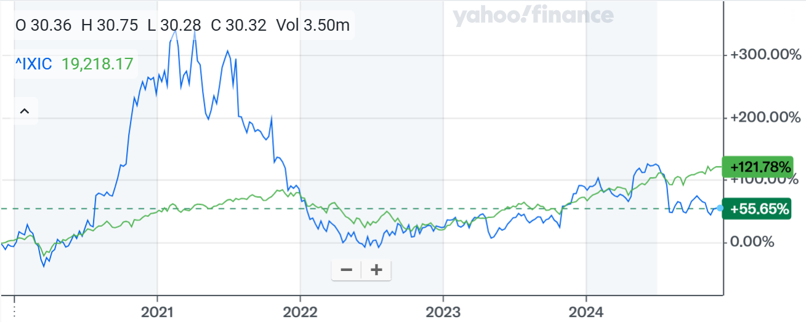
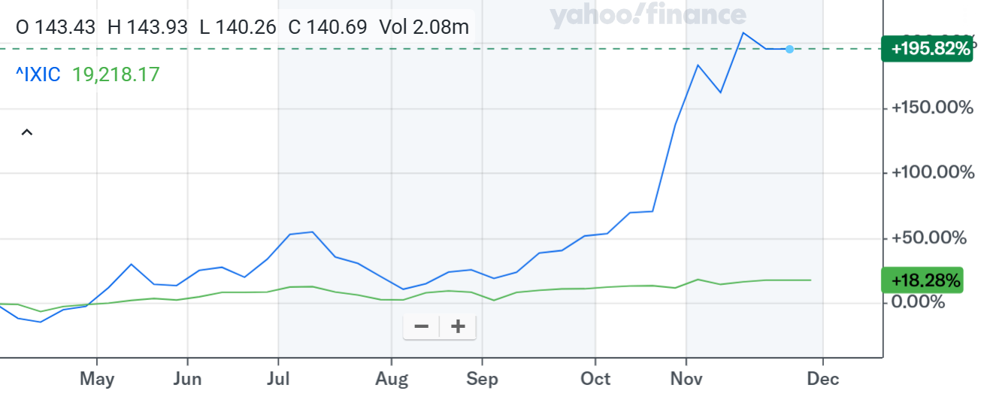
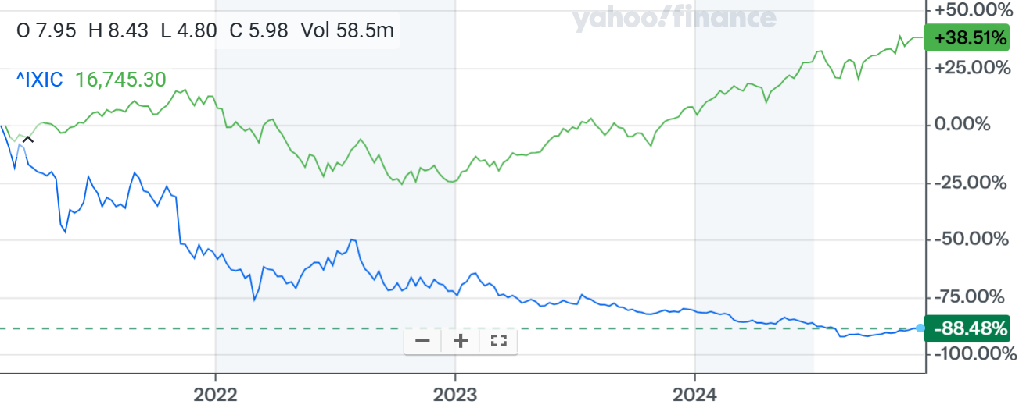
Competitors – Financial Overview
(Online Dating and Social Media Industry)
Business Model |  | Regional Revenue
 | Revenue Segments | N. America | Europe | Others
Meta | Advertising and Non-advertising including VR hardware ​ | $77,546.2 | $41,478 | $61,315
Match Group | Subscription revenue and In-app purchases | $1,778.5 | $1,778.5
Snap | Advertising and AR commerce tools | $4,049.61 | $1,115.1 | $704.28
Pinterest | Advertising revenue and emerging shopping integration | $3,289.02 | $401.1 | $320.88
Reddit | Advertising and Premium memberships | $1,294.8 | $265.2
Bumble | Subscription revenue and In-app purchases | $732.2 | $313.8
5-Year Share Price Performance
NASDAQ -> green
Meta Platforms (META)
Match Group (MTCH)
Operating Performance
 | Revenue | CAGR (5yr) | CAGR(NTM) | EBITDA | CAGR (5yr) | CAGR (3-5yr) | EBITDA
(US$m) | NTM | Historic | Forecast | NTM | Historic | Forecast | Margin
Meta | $1,80,340 | 19% | 15.3% | $1,10,747 | 19% | 17% | 61%
Match Group | $3,557 | 12% | 2.2% | $1,315 | 12% | 6% | 37%
Snap | $5,869 | 27% | 12.2% | $652 | 27% | 15% | 11%
Pinterest | $4,011 | 28% | 14.6% | $1,123 | 28% | 17% | 28%
Reddit | $1,560 | N/A | 39.1% | $409 | N/A | 37% | 26%
Bumble | $1,046 | 24% | -4.2% | $289 | 24% | 2% | 0.3%
Snap Inc. (SNAP)
Pinterest Inc. (PINS)
Reddit Inc. (RDDT)
Bumble Inc. (BMBL)
Capital Structure and Valuation (LTM)
(US$m) | EV* | Market Cap* | Debt | Cash | Net Debt/EV | EV/EBITDA* | P/E*
Meta | $13,76,916 | $13,98,769 | $49,047 | $70,900 | 1.6 | 17.4x | 25.2x
Match Group | $17,790 | $7,711 | $3,940 | $861 | 28.5 | 10.9x | 12.4x
Snap | $18,827 | $17,778 | $4,241 | $3,192 | 5.6 | -24.5x | -18.6x
Pinterest | $10,790 | $19,085 | $154 | $2,443 | 13.6 | 94.8x | 88.4x
Reddit | $20,191 | $21,909 | $27 | $1,745 | 8.5 | -33.9x | -40.8x
Bumble | $1,746 | $851 | $632 | $252 | 21.8 | 9.2x | 1.4x
Sources: Bloomberg, CapIQ

Slide 22
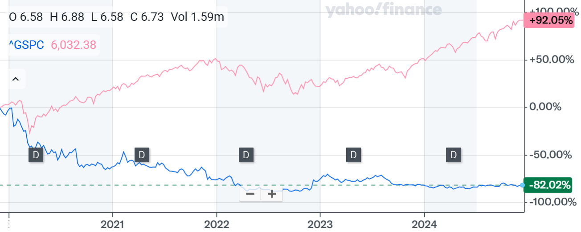
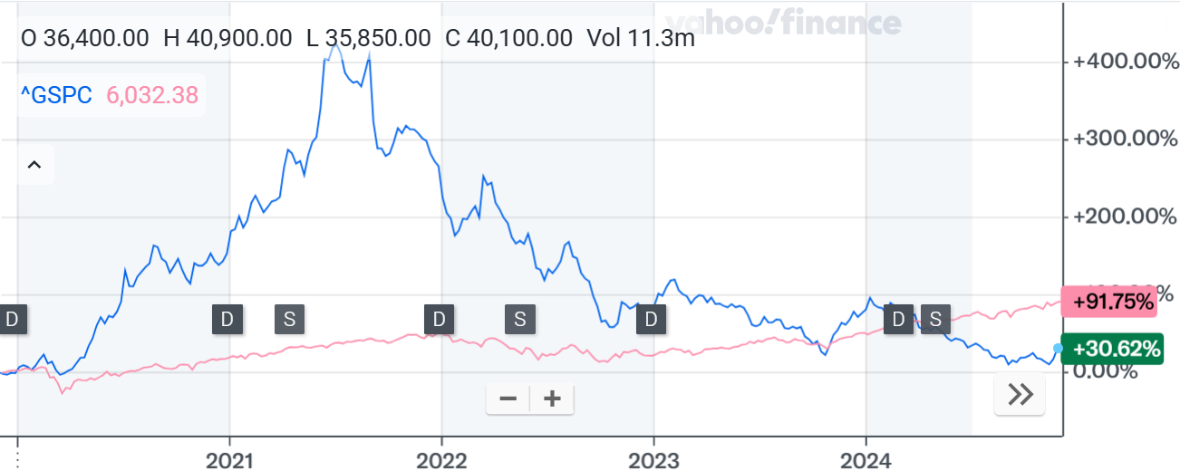
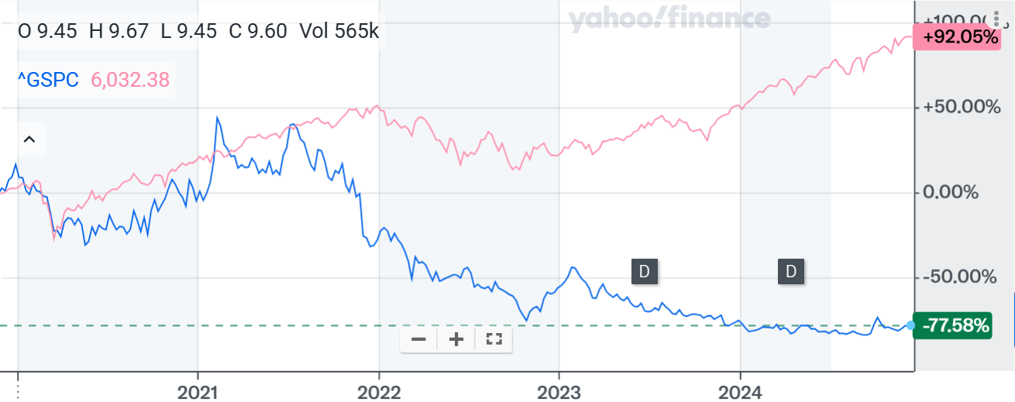
Competitors – Financial Overview
(Online Dating and Social Media Industry)
Stock Price v/s S&P500
S&P500 -> pink
Hello Group
Kakao Corp.
Weibo Corp.
Operating Performance
 | Revenue | CAGR (5yr) | CAGR (NTM) | EBITDA | CAGR (5yr) | CAGR (3-5yr) | EBITDA Margin
(US$m) | NTM | Historic | Forecast | NTM | Historic | Forecast
Hello Group | $1,450 | -6% | -13.9% | $225 | -6% | -3% | 15%
Kakao Corp. | $10,55,778 | 21% | 0.69% | $1,80,592 | 21% | 9% | 17%
Weibo Corp. | $1,748 | 29% | -0.84% | $532 | 29% | 2% | 30%
Yelp Inc. | $1,448 | 7% | 0.55% | $354 | 7% | 6% | 24%
Capital Structure & Valuation
(US$m) | EV | Market Cap | Debt | Debt/EV | EV/EBITDA (LTM) | P/E (LTM)
Hello Group | $842 | $1,185 | $530 | 41% | 2.8x | 6.1x
Kakao Corp. | $20,96,980 | $19,17,965 | $5,98,077 | 16.5% | 12.2x | -16.3x
Weibo Corp. | $1,939 | $2,032 | $2,657 | 9.3% | 3.5x | 6.3x
Yelp Inc. | $2,016 | $2,366 | $54 | 17.4% | 12.7x | 20.1x

Slide 23
Industry – Diagram (Online Dating Space)
Online Dating Industry (Total revenue = 8.64 billion USD)
Technology Infrastructure
Platforms
(Service providers)
Users
Monetisation
Models
Key elements are:
AI and Matchmaking Algorithms: These determine the suitability of matches based on user preferences and behavior.
Cloud Infrastructure: Ensures scalability and the ability to handle millions of user interactions.
Security Technologies: Safeguard users’ personal data, encrypt chats, and provide fraud detection.
Location-based Services: Help connect people based on proximity.
Payment Systems: Facilitate transactions for premium features or subscriptions.
Role: These are the businesses that operate the online dating services. Popular platforms include Tinder, Bumble, OkCupid, Match.com, and niche platforms catering to specific user needs (e.g., eHarmony for serious relationships, Grindr for LGBTQ+ individuals).
Key Functions:
User Experience (UX): Creating an engaging and seamless experience for users.
Communication Tools: Messaging, video chat, voice calls, and virtual gifts to foster interaction.
Types of Users:
Casual Daters: Seeking short-term connections or casual relationships.
Serious Daters: Focused on long-term commitments or marriage.
Niche Groups: Includes LGBTQ+, religious, or age-specific users.
Interrelation with Other Segments:
Platforms: Customize offerings based on user needs and behaviors.
Technology Infrastructure: Enables matchmaking, messaging, and secure interactions.
Key models include:
Freemium Model: Users can access basic features for free, with the option to pay for premium features like unlimited swipes, profile boosts, and visibility.
Subscription Model: Users pay a regular fee for access to all or additional features (e.g., Tinder Plus, Bumble Boost, Match.com Premium).
In-App Purchases: Users can buy virtual gifts, boosts, super likes, or other items to enhance their experience.
Advertising: Platforms may display ads to free-tier users or through partnerships and sponsored content.

Slide 24
Industry – Diagram (Online Dating Space)
Interrelationship between the various components of the relationship
Technological
Infrastructure
Platforms
Users
Monetization models
Innovations in technology enhance the scalability and efficiency of platforms. Matchmaking, payments and data storage are all dependent on technological infrastructure
Platforms attract users through their content. User feedback and behavior patterns, in turn, drive platform improvements and feature development.
Users fuel monetization by subscribing to premium features, making in-app purchases, or engaging with ads. User engagement directly impact revenue generation .
Revenue from monetization is reinvested into the technological infrastructure to enhance system capabilities, introduce new features, and improve data security, creating a feedback loop.
Platforms
Users
Monetisation Models
Technological
Infrastructure

Slide 25
Company – Strategic & Financial Objectives
Strategic Objectives | Financial / Operational Objectives
Optimize user acquisition through targeted marketing campaigns, strategic partnerships, and influencer collaborations. Diversify platform offerings by enhancing Bumble’s BFF (friendship) and Bizz (networking) segments alongside the core dating platform. Enhance safety and trust with continued investment in AI-powered moderation tools, profile verification, and women-first policies. Grow international market share by localizing features and campaigns tailored to emerging markets. Innovate user engagement through features like video calls, virtual dating options, and interest-based matchmaking tools. Increase monetization opportunities by optimizing subscription models, in-app purchases, and ad-based revenue streams. | Achieve sustainable revenue growth by increasing premium subscription uptake and expanding freemium offerings. Fund strategic platform enhancements with reinvestment into technology, AI moderation, and new feature development. Maintain profitability through effective cost management and operational efficiencies. Drive international expansion to capture untapped markets with tailored marketing and user experience. Build long-term brand loyalty through safety-first initiatives, inclusivity campaigns, and user-centric innovations. Pursue partnerships and acquisitions that align with Bumble’s growth vision, such as niche apps and community-driven platforms.

Slide 26
Company – Strategic Objectives
Building a strong user engagement platform with innovative features enhances Bumble’s long-term competitive positioning​
​AT&T Over-the-Top Streaming
Development of Bumble’s In-House Social & Dating Platform
Industry Trend
Differentiation
Monetization
Online dating platforms are rapidly growing due to increasing smartphone adoption and ​changing social norms.​
Bumble’s key differentiator: Women make the first move, creating a safer and unique environment for users.​
Premium subscription features for added perks (e.g., Boosts, Spotlight, Super Swipe).
Freemium model: Free access with paid upgrades for additional functionality.
Shift towards safety and inclusivity in online dating spaces driven by user demand for respectful interactions.​
Expanding features like Bumble BFF and Bumble Bizz to diversify offerings.
Market shift to relationship-focused platforms as opposed to casual dating.
Investment in AI moderation and profile verification tools to ensure authenticity and safety

Slide 27

Company – Background
BUMBLE Inc.
History and Strategy | Operations
Bumble was founded in 2014 by Whitney Wolfe Herd, a former co-founder of Tinder, with Andrey Andreev, founder of Badoo. Ownership (initially): Andrey Andreev (79%), Whitney Wolfe Herd (21%). In its early phase, Bumble generated modest revenues primarily through subscription plans and in-app purchases. Bumble’s primary strategy is the “Women’s First Approach,” i.e., in heterosexual matches, women make the first move. | Whitney Wolfe Herd, the founder and CEO of Bumble, has stepped down from her role and succeeded by Lidiane Jones from January 2024 It operates through three modes: Bumble (for dating), BFF(for making friends), and Bizz (for professional networking). Planned acquisition of Geneva, Bumble Inc. aims to rapidly expand the Bumble For Friends experience from one-to-one connections to groups and communities to serve the many ways people seek friendships.
Financial Stats/Performance | Marketing Strategies
Stock price has been declining since its launch (-88.97%). FY24E Revenue: $1.3bn, FY24E EBITDA: $107mm. Historic Revenue CAGR (5yr): 17.66% (as of September 2024) Total Capex: $8.32mm (Last 12 months) Cash & Cash Equivalents: $252.1mm | “Find Them on Bumble” initiative, featuring their stories on billboards, on social media and through local events. In 2019, the company partnered with GLAAD to expand its gender options, allowing users to choose from more than 100 gender identities. “Queen Bee Program”, which identifies and empowers local influencers to become brand ambassadors on college campuses.
Corporate Finance Transactions | Key Properties & Developments
Bumble IPO (2021) Acquisition of Fruitz (Feb 2022): At a valuation of $69.7mm Acquisition of Official (May 2023): At a valuation of $9.8mm | Bumble has its headquarters in London, UK and Texas, US. Includes intellectual property, trademarks, and brand value, particularly for its apps: Bumble, Badoo, Fruitz and Official. Extended its reach to Europe with the acquisition of Official.
27

Slide 28

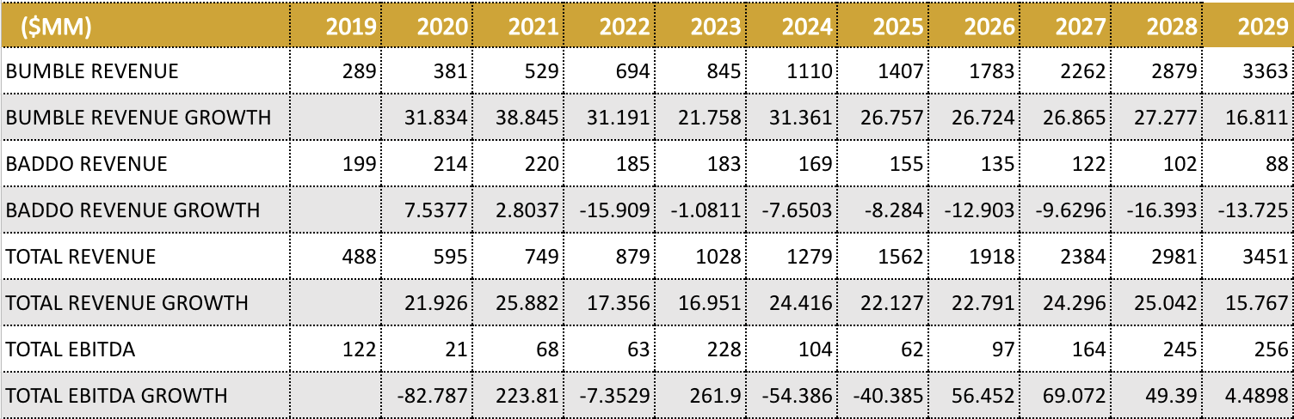
Company – Operating Cost
Revenue Drivers
Bumble’s primary revenue source comes from subscriptions like Bumble Boost, Bumble Premium, and Badoo Premium.
Features like SuperSwipes and Spotlights have increased the number of paying users.
Heavy investments in AI safety features and innovation contributed to enhanced user trust, indirectly driving higher retention and conversions.
The “woman-first” approach followed by Bumble attracts more female users and makes it the leading dating app in terms of female users.
Expanding into emerging markets through acquisition provides bumble user growth and subscription revenue.
Its expedition beyond dating through Bizz and BFF provided a wide range of platform to the users.
Revenue and EBITDA Forecast

Slide 29
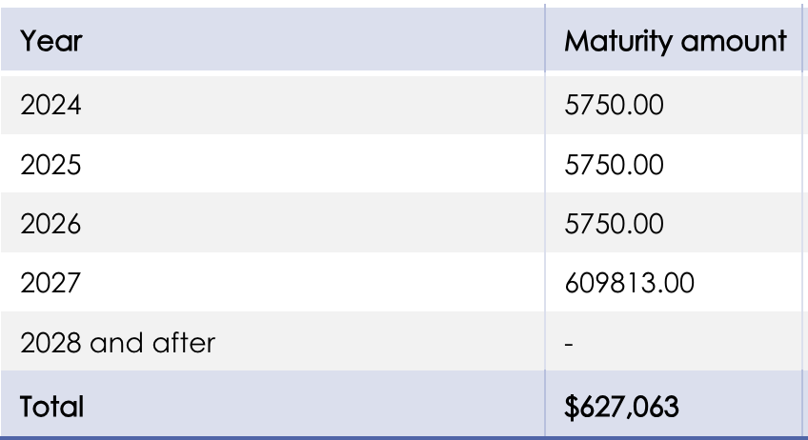
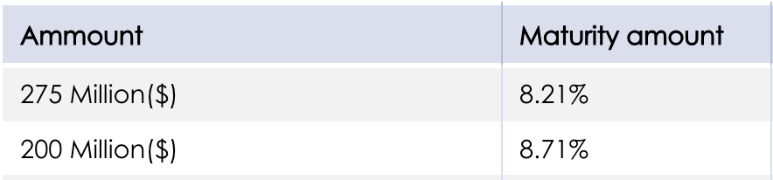
Company – Capital Requirements
Capital requirements and development expenditures can comfortably be served from internal cashflows although Bumble retains significant cash on hand to opportunistically pursue acquisitions.
Capital Requirements
Capital Requirements
Marketing and User Acquisition: Significant spending on advertising campaigns, influencer partnerships, and local market strategies to attract and retain users.
Product Development: Continuous investment in-app features, AI technologies, and safety measures like Deception Detectors.
Operational Infrastructure: Ongoing costs for app store fees, cloud hosting, data centers, and fraud prevention.
Global Expansion: Entry into new markets requires capital for localization, regulatory compliance, and infrastructure setup.
 | 2021 | 2022 | 2023 | 2024E | 2025E | 2026E | 2027E | 2028E | 2029E | 2030E
Historical & Forecasted Capex ($mm) | 12 | 86 | 25 | 65 | 65 | 84 | 104 | 141 | 177 | 230
Capex/ Net Sales | 1.6% | 9.5% | 2.4% | 4.9% | 3.9% | 4.1% | 3.9% | 4.2% | 4.1% | 4.1%
Long Term Debt Repayment ($mm) | 620 | 619 | 615 | 1,163 | 1,235 | 1,268 | 1,307 | 1,355 | 1412 | 1463

Slide 30
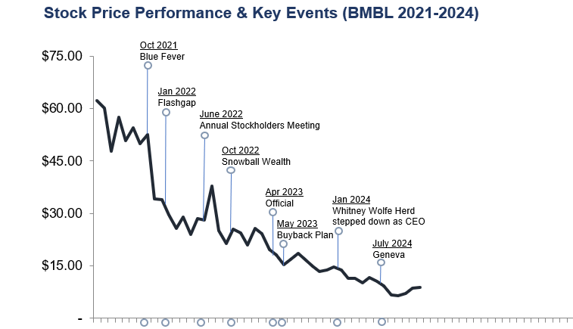
Valuation – Share Price (Bumble)
Key Events & Share Price Drivers
05-Oct-2021: Blue Fever - Bumble’s early-stage investment in Blue Fever, a supportive social platform for mental wellness, reflects a strategic move to integrate mental health and emotional support services into its offerings .
31-Jan-2022: Flash gap - A time-delayed photo-sharing app, aligns with Bumble’s focus on building creative social platforms.
18-Oct-2022: Snowball Wealth - Bumble's participation in Snowball Wealth’s seed round signifies an interest in integrating financial tools or resources into its ecosystem, particularly to support women-focused financial empowerment .
26-Apr-2023: Official - It is a relationship management app that promotes connections among couples. Bumble's acquisition aimed at expanding its user base by offering tools to strengthen romantic relationships beyond initial matches.
01-Jul-2024: Geneva - Bumble acquired Geneva, a platform known for fostering group communication and community management. This acquisition aligns with Bumble's focus on enhancing its social networking and community-building capabilities.
It can be noted that initial acquisitions incited a negative reaction from the market . Investors were unhappy with how the company was managing its profits . Bumble has a strategy of buying back its own stock , when the stock is undervalued.

Slide 31
Discounted Cashflows Overview
DCF valuation in line with current price as upside from strong forecasted cashflows is slightly counteracted by low target gearing which increases WACC
Strong cashflow forecasts are supported by record results achieved in 2023, reflecting solid financial performance and growth.
A moderately conservative terminal growth rate translates to an 8.9x EBITDA multiple, ensuring a balanced long-term outlook.
A WACC of 16.6%, driven by a beta of 1.63 and a pre-tax cost of debt of 7.9%, reflects the business's hit-driven nature and market sensitivity.
EBITDA CAGR of 19.5% and Revenue CAGR of 24.5% highlight the company’s strong growth trajectory and operational success.
DCF Valuation Results
($ in millions of U.S. dollars except per share amounts) Projected Fiscal Years Ending March 31
Free Cash Flows
2024
2025
2026
2027
2028
2029
2030
2031
EBIT * (1-tax rate) | 37 | 49 | 60 | 60 | 72 | 99 | 127 | 156
Depreciation And Amortization | 204 | 204 | 268 | 310 | 410 | 507 | 646 | 819
Stock based compensation | 75 | 92 | 113 | 140 | 175 | 220 | 280 | 356
Other | 0 | 0 | -0 | -0 | 0 | 0 | 0 | 0
Capex | (64) | (62) | (78) | (95) | (125) | (153) | (1) | ()
Net Change in Working Capital | 40 | 75 | 25 | 72 | 79 | 146 | 168 | 197
Free Cash Flows to Firm (FCFF) | 117 | 124 | 104 | 201 | 271 | 348 | 4 | 539
Years to Discount | 1 | 1 | 2 | 3. | 4 | 5 | 6 | 7
Cost of Capital | 16.6% | 16.6% | 16.6% | 16.6% | 16.6% | 16.6% | 16.6% | 16.6%
Discount Factor | 1 | .86 | 0.74 | 0.63 | 0.54 | 0.46 | 0.40 | 0.34
PV Free Cash Flows to Firm (FCFF) | 117 | 106 | 76 | 127 | 146 | 161 | 168 | 184
Enterprise Value EBITDA Multiple Method |  |  |  | WACC Assumptions
EBITDA Multiple Terminal Year EBITDA | 8.9x 434 |  |  | Valuation date 10-yr US government bond rate | DEC-24 4.25%
 |  |  |  | Expected market return | 15.4%
Present Value of Terminal Value | 1,318 |  |  | Market risk premium | 11.2%
Present Value of Forecast FCF | 1,086 |  |  | Beta | 1.63
Enterprise Value | 2,404 |  |  | CAPM cost of equity | 22.4%
- Debt | 632 |  |  | Cost of debt | 7.9%
+ Cash | 2,52 |  |  | Tax rate | 21.0%
Equity Value (Market Cap) | 1,510 |  |  | After tax cost of debt | 6.2%
Shares outstanding | 157 |  |  | Target gearing | 36%
Fair value share price | $9.60 |  |  | WACC | 16.6%

Slide 32
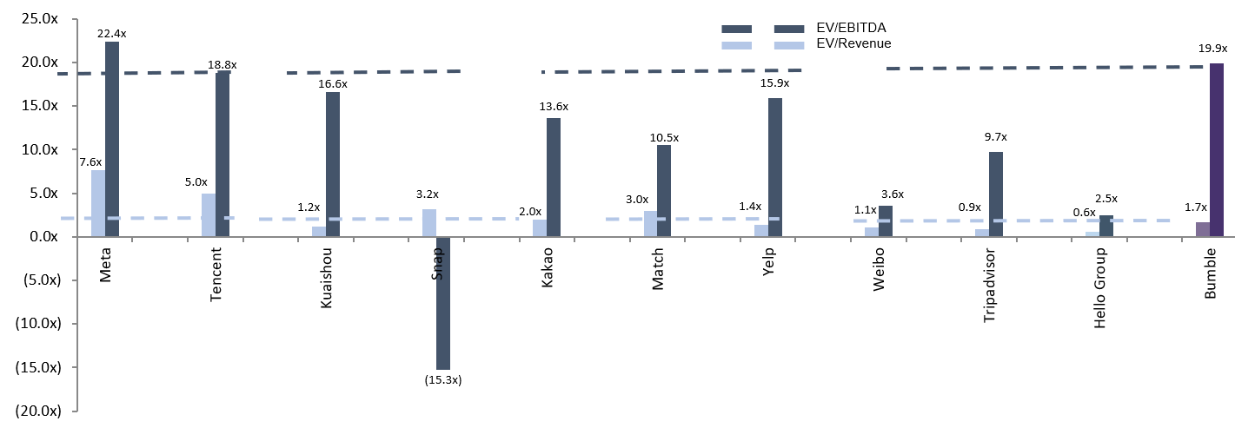
Trading Comparables Overview (Bumble)
Trading Comparables Dataset (NTM Forward Multiples)
Bumble is moderately valued compared to its peer group.
Companies chosen for EV/Revenue multiple include Pinterest, Snap, Hello group, Match Group and Kakao Corp.
Companies chosen for EV/EBITDA multiple include Hello Group, Match Group and Kakao Corp.
Bumble is trading at a discount relative to its peers. This indicates undervaluation.

Slide 33




Valuation – Trading Comparables (Bumble)
Bumble business overview in brief:
Innovative Dating Platform: Bumble empowers women by letting them make the first move in dating, friendships, and professional connections.
Global Reach: Operates in over 150 countries with a diverse and growing user base.
Monetization Strategies: Revenue driven through subscriptions, in-app purchases, and advertising.
EV/REVENUE
EV/EBITDA
Companies chosen:
Pinterest: With a multiple of 4.2x, it is a good contender. Moreover, the ad-based revenue model is similar to bumble.
Snap: Similar target audience as bumble . Its multiple is 3.2x. User-engagement and ad-based revenue are common themes to bumble.
Hello: Its industry multiple is 0.6x. Though lower, the core business model is same as bumble. The company is exclusive to China.
Kakao: Its industry multiple is 2.0x. Subscription and ad-based revenue generation. Some business models have similarity to bumble as well.
Match : With an industry multiple of 3.0x Companies under match group (Tinder ,OkCupid) are outright competitors of bumble.
Companies chosen:
Hello: Its industry multiple is 2.5x. Though lower, the core business model is same as bumble. The company is exclusive to China. EBITDA reflects the ability of the company to scale effectively, which is a useful comparator.
Kakao: Its industry multiple is 13.6x..Highlights profitability across diversified revenue streams, useful for contextualizing Bumble’s potential for expansion into related services.
Match : With an industry multiple of 10.5x, near about bumble(9.2x) and being outright competitors, match group is an obvious choice for both multiples. Match also demonstrates profitability at a larger global scale, setting a benchmark for Bumble's growth potential.

Slide 34
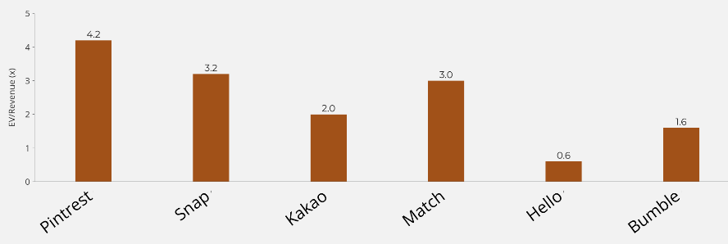
Valuation – Trading Comparables
Trading Comparables Peer Group (for EV/Revenue multiple)
VALUATION CONCLUSIONS
Bumble is trading at a discount with respect to its peers.
This is indicative of undervaluation and skepticism in the market. Good time for investment into the company.
Bumble depends on a single revenue stream, unlike its peers.
Its revenue has also not increased as steadily as its peers.
Multiples are NTM
Comparable Set: Includes Match Group, Kakao, Snap, Pinterest, and Hello Group, representing companies in the digital social networking, communication, and content-sharing space. Revenue Models: These firms emphasize user engagement-driven revenue streams such as advertising, subscriptions, and in-app purchases. Focus Areas: Match Group & Hello Group: Primarily focus on dating and social connections. Snap & Pinterest: Cater to creative content sharing and advertising. Kakao: Integrates messaging with broader ecosystems, including e-commerce and entertainment. Purpose: This diverse and well-rounded comparable set provides an effective basis for EV/Revenue evaluation.
BUMBLE VALUATION
Current Market Valuation
EV/Revenue: 1.7x
Trading Comps Valuation
EV/Revenue: $1.046 billion

Slide 35
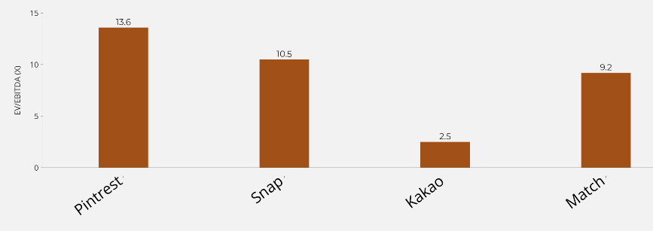
Valuation – Trading Comparables
VALUATION CONCLUSIONS
Bumble is trading at an EV/EBITDA of 9.2x, lower than Kakao (13.6x) and Match Group (10.5x), but significantly higher than Hello Group (2.5x). This indicates that Bumble is moderately valued relative to its peers, reflecting market skepticism about its profitability, yet not as undervalued as Hello Group. It could be a balanced entry point for investment, especially if operational efficiencies improve.
However, Bumble's EBITDA margins may lag behind higher-multiple peers like Kakao and Match, which benefit from diversified revenue streams and operational scale, while Hello’s lower multiple highlights potential concerns around growth or profitability sustainability.
Note: Multiples are NTM
Trading comparable peer group(for EV/EBITDA multiple)
Comparable Set for EV/EBITDA: Includes Hello Group, Match Group, and Kakao, focusing on companies in digital communication and social networking.
Operational Focus: These firms demonstrate strong operational efficiency and profitability through scalable platforms and high user monetization potential.
Revenue Models:
Match Group & Hello Group: Emphasize subscription-based revenue streams.
Kakao: Diversifies income through advertising and ecosystem services.
Purpose: This comparable set is ideal for evaluating valuation based on core earnings and operational performance.
VALUATION OF BUMBLE
Current Market Valuation:
EV/EBITDA: 19.9x
Trading Comps Valuation
EV/Revenue: $2.565 billion

Slide 36
Bumble Overview
Precedent Transaction Synopsis (Bumble)
Description
Bumble was launched in 2014 by Whitney Wolfe Herd as a dating app emphasizing female empowerment by requiring women to make the first move, distinguishing it as a feminist alternative to other dating platforms.
The company expanded its offerings beyond dating to include professional networking and friendships through features like Bumble BFF and Bumble Bizz, and acquired complementary apps such as Fruitz and Geneva to appeal to younger demographics and foster community connections.
Bumble went public in February 2021, raising over $2 billion and achieving a market valuation exceeding $13 billion, with steady revenue growth driven by increased paying users and international expansion.
Lifecycle
Timeline highlighting significant events throughout the lifecycle of Bumble
2014 | 2015 | 2016 | 2017 | 2019 | 2021 | 2022 | 2024
Founded as "feminist app"
Bumble reaches 1 million users
Bumble BFF is launched
Bumble Bizz is launched
IPO is launched
Blackstone Group acquires a majority stake in MagicLab, the parent company of Bumble and Badoo
Acquires Fruitz, a rapidly growing dating app popular among Gen Z users in Europe.
Acquires Geneva, a group and community app designed for people to connect based on shared interests

Slide 37
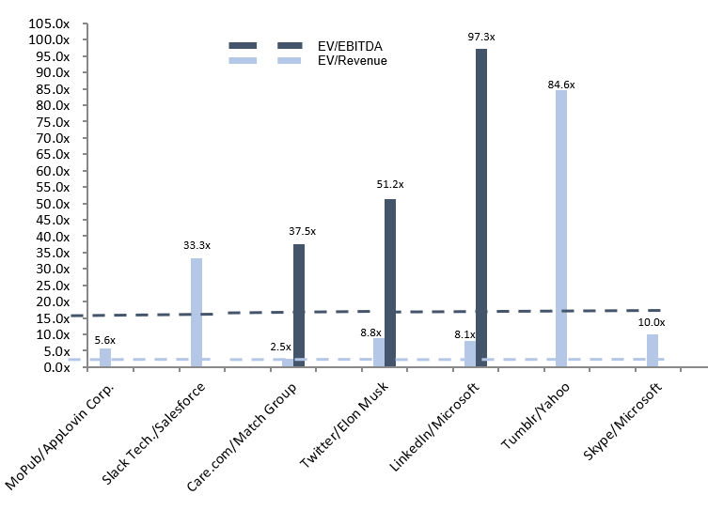
Precedent Transactions Dataset (LTM Multiples)
Precedent Transactions Overview (Bumble)
Precedent Transactions Valuation multiples for EV/Revenue and EV/EBITDA are 2.5x and 18.8x respectively.
The transactions chosen for valuation of Bumble are Care.com/Match Group and MoPub/AppLovin Corp.
The fair value share price for Bumble according to precedent transactions valuation is $15.06 - $20.35.

Slide 38

Precedent Transaction Synopsis
(Care.com/Match Group)
Match Group History & Background
Care.com Acquisition (Dec 2019)
Streams Revenue
Tinder | $1.92bn
Evergreen & Emerging | $691.4mm
Hinge | $396.5mm
Match Group Asia | $302.6mm
Key Financials (LTM) |  | LinkedIn Acquisition (LTM)
Revenue | $207mm | Offer Price | $15 per share
EBITDA | $14mm | Implied EV | $525mm
Net Profit | $52.9mm | EV/Revenue | 2.5x
Equity Funding | $107mm | EV/EBITDA | 37.5x
Advertising | $56.4mm
History
Offer Process
1995: Match.com, one of the first online dating services, was founded by Gary Kremen and Peng T. Ong.
2003: Became part of IAC's portfolio .
2008: Match Group was officially established under IAC to oversee online dating services.
2015: Launched as a standalone publicly traded company under the ticker symbol MTCH on NASDAQ.
2019: Match Group became fully independent from IAC after a spin-off.
M/A activities
2011: Acquired OkCupid for $50 million, expanding its presence in the dating industry.
2014: Acquired Tinder, a fast-growing dating app known for its swipe feature, becoming a dominant player in mobile dating.
2016: Acquired PlentyOfFish, a popular free dating platform, for $575 million.
2018: Acquired Hinge, a relationship-focused dating app, which has since become one of its fastest-growing brands.
December 19, 2019 -> IAC(InterActiveCorp), which also owns Match Group announced its agreement to acquire Care.com for $15 per share in an all-cash deal valuing the company at approximately $525 million. This marked the start of the tender offer .
January 13, 2020 -> IAC officially launched its tender offer to purchase all outstanding shares of Care.com .
February 10, 2020 -> The tender offer expired. By this date, IAC had acquired approximately 81.3% of Care.com’s outstanding shares .
February 11, 2020 ->The merger was completed, making Care.com a wholly-owned subsidiary of IAC. Following the merger, Care.com shares were delisted from the New York Stock Exchange .
This acquisition allowed IAC to integrate Care.com into its portfolio, leveraging its digital expertise to address growing family care needs alongside its other business units like Match Group .

Slide 39


Precedent Transaction Synopsis (LinkedIn/Microsoft)
Microsoft History & Background
LinkedIn Acquisition (Dec 2016)
Major Products Revenue
Operating Systems (Windows) | $22 bn
Office Software (Microsoft 365) | $49 bn
Cloud Computing Services (Azure) | $80 bn
Gaming Consoles (Xbox) | $15 bn
Key Financials (LTM) |  | LinkedIn Acquisition (LTM)
Revenue | $3,214mm | Offer Price | $420.0mm
EBITDA | $266mm | Implied EV | $25,880mm
Net Income | $166mm | EV/Revenue | 8.1x
Debt to Equity | 0.23 | EV/EBITDA | 97.3x
Employment Listing Platform | $15 bn
History
Offer Process
April 4, 1975: Microsoft founded by Bill Gates and Paul Allen in Albuquerque, New Mexico.
August 12, 1980: IBM partners with Microsoft, leading to the development of MS-DOS.
March 13, 1986: Microsoft goes public with an initial price of $21 per share, raising $61 million.
1999: Microsoft becomes the most valuable company in the world.
M/A activities
May 10, 2011: Microsoft acquires Skype for $8.5 billion.
June 13, 2016: Announces acquisition of LinkedIn for $26.2 billion.
October 26, 2018: Completes acquisition of GitHub for $7.5 billion.
January 18, 2022: Announces plans to acquire Activision Blizzard for $68.7 billion.
June 13, 2016 -> Microsoft announced its intent to acquire LinkedIn for $26.2 billion in an all-cash deal. LinkedIn's CEO, Jeff Weiner, would remain in his role and report directly to Microsoft CEO Satya Nadella.
July 2016 -> Regulatory filings began, and Microsoft outlined its strategic intent to integrate LinkedIn's professional networking capabilities with Microsoft's productivity tools.
August 19, 2016 -> LinkedIn shareholders approved the acquisition with 99.5% of votes in favor. This was a critical step in completing the transaction.
November 22, 2016 ->The European Commission approved the acquisition after Microsoft committed to maintaining competition.
December 8, 2016 -> The deal officially closed. LinkedIn maintained its brand, culture, and autonomy under Jeff Weiner’s leadership while being fully integrated into Microsoft's broader enterprise portfolio​.
Pre-acquisition ownership of LinkedIn: Before Microsoft's acquisition of LinkedIn, the company was publicly traded with significant institutional and individual ownership. Reid Hoffman, LinkedIn's co-founder, was one of the largest shareholders and played a key role in approving the deal.

Slide 40

Precedent Transaction Synopsis (WhatsApp/Meta)
WhatsApp Acquisition (Feb 19 2014)
WhatsApp Background
Key Statistics (User Base)
US | 29%
Asia | 50%
Other | 21%
Overview: WhatsApp is a globally popular instant messaging platform that allows users to send text, voice, video messages, and make calls using internet connectivity. It has become a key communication tool in over 180 countries, with more than 2 billion active users.
Ownership (Pre-Acquisition): Jan Koum(Co-founder & CEO) (45%) , Brian Acton(Co-founder) (20%) , Sequoia Capital (18%) , Early Employees (17%) .
Key Financials (LTM) |  | Acquisition Valuation
Revenue | $10mm | Implied EV | $20,071mm
EBITDA | $-138mm | EV/Revenue | 2007.1x
Debt to Equity | 0.27 | EV/EBITDA | 145.4x
Transaction Rationales
Expanding User Base -> WhatsApp had over 450 million monthly active users at the time of the acquisition, with 70% daily activity. It was one of the fastest-growing apps globally.
Minimizing Competition -> Acquiring WhatsApp neutralized a potential threat. WhatsApp was on a trajectory to grow into a significant competitor that could rival Facebook's dominance in the social and communication space.
Revenue Opportunities -> Although WhatsApp had minimal revenues at the time, Facebook saw long-term monetization opportunities through premium features, business messaging, and integrating it into its ecosystem.
Capital Structure
Implied EV | $20,071mm
Share | $12 bn | In Facebook shares*
Cash Issued | $4 bn | Cash for Acquisition
Employee compensation | $3 bn | Restricted stock units for WhatsApp’s founders and employees
Transaction Risks
WhatsApp's strong emphasis on user privacy (e.g., end-to-end encryption and limited data collection) clashed with Facebook's data-driven business model.
The $19 billion valuation was a massive premium, especially for a company that had limited revenue streams at the time. This raised questions about whether the valuation was sustainable and if Facebook could generate a return on investment.
Integrating WhatsApp's infrastructure with Facebook's systems posed challenges, particularly while maintaining privacy standards and complying with global regulations.
Accretion: The deal was seen as dilutive to Facebook's earnings because WhatsApp did not generate significant revenue or profits at the time of the acquisition.
Synergies: Expanded Facebook's global user base and further solidified its position in global messaging and communications.
Leverage: Facebook financed the WhatsApp acquisition primarily through its stock (about $12 billion) and cash ($4 billion), with no significant debt involved. This structure minimized Facebook's financial leverage, meaning the acquisition was largely equity-financed.

Slide 41
Precedent Transaction Synopsis
(Twitter/Elon Musk)
April 14, 2022: Elon Musk makes an offer to buy Twitter outright for $44 billion, at $54.20 per share, stating his intention to take it private and emphasizing his focus on free speech.
Offer Process
Jan, 2022
Elon Musk begins acquiring Twitter shares discreetly.
Apr 4, 2022
Musk publicly discloses his 9.2% stake in Twitter, becoming the company’s largest shareholder.
Apr 9, 2022
Musk declines the board seat, citing potential limitations on owning more than 14.9% of the company.
Apr 14, 2022
Musk makes an offer to buy Twitter outright for $44 billion, at $54.20 per share, stating his intention to take it private and emphasizing his focus on free speech.
Apr 25, 2022
Twitter’s board accepts Musk’s $44 billion buyout offer.
July 8, 2022
Musk officially moves to terminate the deal, claiming Twitter failed to provide sufficient information about spam bots.
July 12, 2022
Twitter files a lawsuit in Delaware Chancery Court to force Musk to complete the acquisition.
Oct 27, 2022
Elon Musk completes the $44 billion acquisition of Twitter. Musk enters Twitter headquarters carrying a sink, tweeting, "Let that sink in." This marks the official closing of the deal.
Oct 28, 2022
Musk dissolves Twitter's board of directors and becomes the sole director and later implements significant layoffs, cutting around 50% of Twitter’s workforce, and begins making changes to Twitter’s policies and subscription models.
Analyst Comments
“Analysts were deeply divided on the Twitter acquisition. While some saw potential for Musk to bring innovation and dynamism to the platform, others expressed serious concerns about the financial, operational, and governance risks associated with his approach. “
"Musk is overpaying for Twitter given its inconsistent financial performance and stagnant user growth." — Dan Ives, Wedbush Securities.
"The debt burden will make Twitter's financial future precarious, especially in a high-interest-rate environment." — David Trainer, New Constructs
"Advertisers may flee if Musk’s changes disrupt the platform’s content moderation and user experience." — Jessica Liu, Forrester.

Slide 42
Restructuring
Restructuring:
Financial restructuring: | Operational restructuring
1. Bumble’s debt/equity ratio is 0.74 as of September 2024.0.74 is healthy but slightly reducing debt could improve Bumble's financial stability, particularly as interest rates fluctuate. 2. Bumble repurchased $89.7 million in shares during Q3, signaling shareholder returns are a priority. However, balancing share buybacks with investments in product innovation and marketing could enhance long-term growth potential​. 3. According to their financial report, Revenue was adversely impacted by foreign currency fluctuations. Bumble can mitigate this by increasing localization efforts and diversifying its geographic revenue sources to stabilize international earnings​. 4. Despite a 10% increase in paying users on the Bumble app, the average revenue per paying user (ARPPU) declined from $23.42 to $21.17. There is a high need for bumble to work on the revenue streams. | 1. Diversify Revenue Streams :Bumble's primary revenue source comes from users subscribing to its paid tiers , such as Bumble Boost and Bumble Premium. Heavy reliance on subscription revenue can make Bumble vulnerable to competitive pressures. Action that can be taken: 1.Implement non-intrusive advertising for free users. 2. Introduce new paid features, such as AI-powered dating insights, compatibility reports, or exclusive virtual dating events. 3.Collaborate with lifestyle brands or travel companies to generate affiliate revenue. 2. Acquire apps focusing on LGBTQ+ dating, niche communities, or friendship-building to diversify offerings. This can help in increasing Bumble’s can increase Bumble's user base and feature set. 3. Bumble has to enhance its brand loyalty as dating apps are not that much trusted in Asian countries, it can be done by collaborating with highly trusted brands among youth or by enhancing its privacy and safety using blockchain.

